Slide 1
Data Science Mini Project
League of legends dataset
Elias, Raj, Brandon

Slide 2
Table of contents
Introduction – League of Legends
Problem Definition #1
Sample Collection and Data Preparation
Exploratory Data Analysis
Conclusion
Problem Definition #2
Sample Collection and Data Preparation
Exploratory Data Analysis
Machine Learning Models
Conclusion

Slide 3

introduction League Of Legends
League of Legends (LoL) one of the most popular online games worldwide, boasting millions of players.
5v5 Multiplayer Online Battle Arena (MOBA), where teams fight against each other in a virtual battlefield called the summoners rift.
League of Legends is a strategic game that demands teamwork, skill, and adaptability.
Notes:
League of Legends developed by Riot Games, is often abbreviated as LoL stands as one of the most popular online multiplayer games worldwide. It is a multiplayer online battle arena (MOBA) where it pits two teams composing of five unique champions, battling against one another on a virtual battlefield called the Summoner's Rift. At its core, League of Legends is a strategic game that demands teamwork, skill, and adaptability. To gain a better understanding of the game here is a short video done by popular youtube ‘Lilypichu.

Slide 4
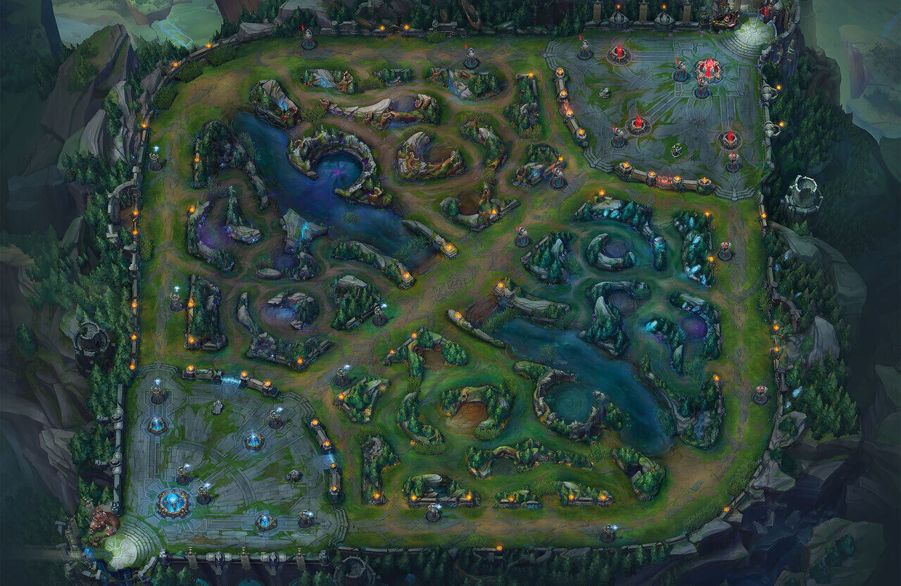







Champions, ROLES & POSITIONS
Composed of 5 unique champions (characters) per team.
Each player controls a champion:
Champions are a diverse set characters with their own set of abilities, strengths, weaknesses and classes.
Some champion classes examples are:
Notes:
In league of legends each player controls a champion, which is a powerful and diverse character with their own set of abilities, strengths, and weaknesses.
These champions are classified into different roles such as mages, warriors, tanks, supports, marksmen, and assassins each fulfilling a specific role/position within a team composition. The game is played in a map called the summoners rift with the 2 team’s bases are here and here and the positions. Top, Mid, Bottom (Bot) & Support and Jungle. Then each position is filled by a player who controls a champion.
The primary objective of League of Legends is to work together with your team to destroy the enemy's Nexus, a heavily fortified structure located within their base.

Slide 5
What champion composition for each position will maximize the chances of winning
Problem Formulation #1
Analyse official competitive matches and identify the best champion class combination that will result in a win.
Objectives.
Acquire the necessary data we needed from the original dataset.
Sample and prepare the data.
Perform data exploration and analysis (EDA).
Based on the observations and findings derive a conclusion.
Notes:
Problem formulation #1: What champion composition for each position will maximize the chances of winning The objective of this project is to analyze data from official competitive matches of League of Legends and identify the best combinations of champions that result in the highest win rates. By leveraging a dataset containing comprehensive information on competitive games and another dataset containing details about individual champions, the aim is to provide insights into champion synergy and strategic compositions that lead to success in professional League of Legends play.

Slide 6
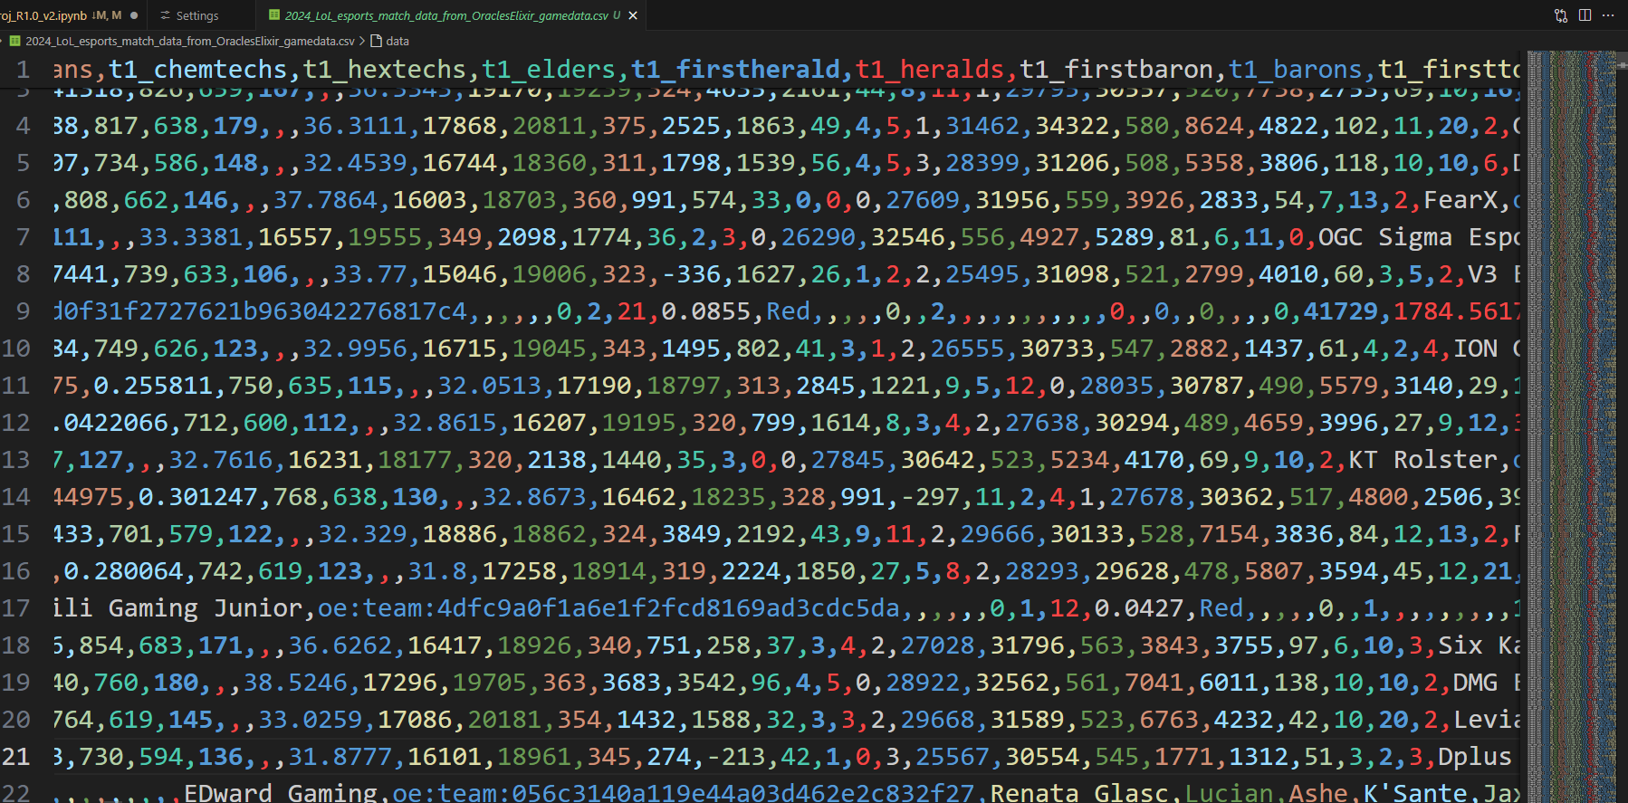
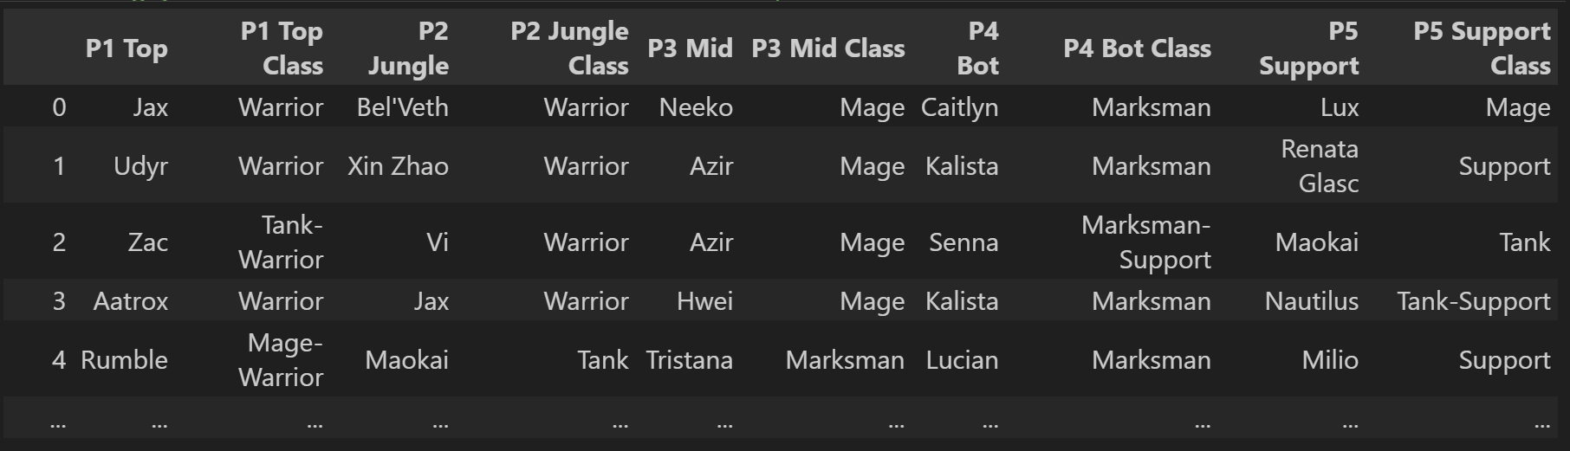
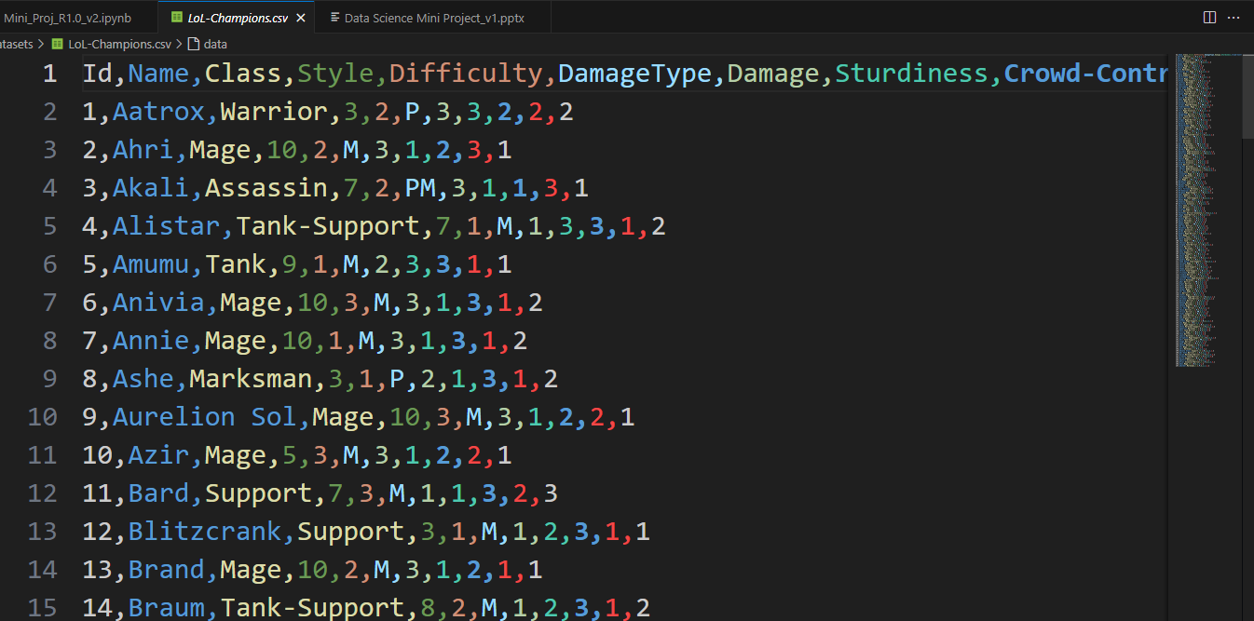
Sample collection & data preparation
https://www.kaggle.com/datasets/barthetur/league-of-legends-2024-competitive-game-dataset
https://www.kaggle.com/datasets/uskeche/leauge-of-legends-champions-dataset
Notes:
We made used of 2 data sets, one contains the competitive games dataset 2024 edition and a champion dataset containing information regarding the different champions in league of legends. To help solve our problem definition we have extracted the necessary data from the 2 dataset and combined them together to generate a clean dataset.

Slide 7

Exploratory data analysis
Analyze the Team Compositions of winning teams
Observe the most optimal champion class for each role
Using visual representations to aid in identifying and confirming what team composition is the best
Gather findings and conclude
Notes:
For our first EDA, our objectives is to analyse the team compositions that have won a match. Observe the compositions of this winning teams and identify the best class for each role in the game. Finally gather our data and conclude what is the best team composition.

Slide 8
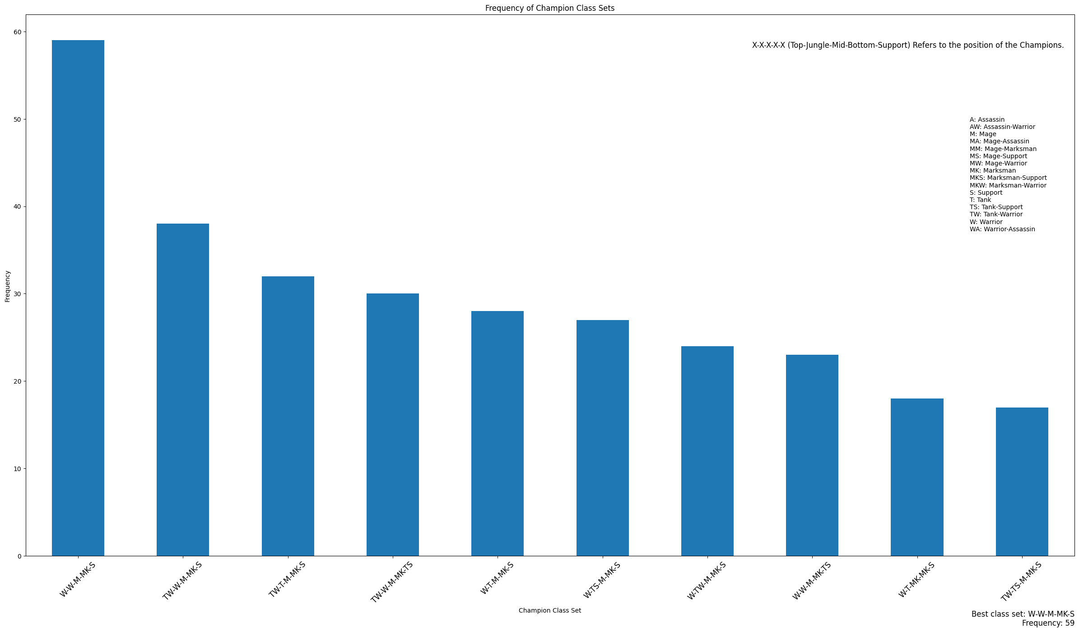
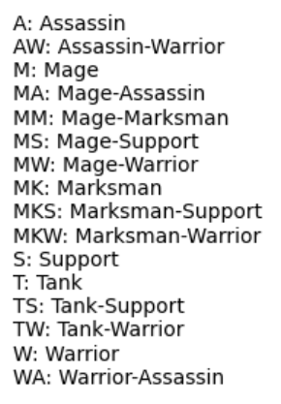
Bar Graph
Notes:
We start off by immediately plotting our cleaned data frame into a bar graph. To see what team composition is the most frequent when it comes to winning games. From the data above it seems that the team compromising of a Warrior – Top and Jungle, Mage for Mid, Marksmen for Bot and Support class for the support role is the most picked composition. To further justify this we proceed with.

Slide 9
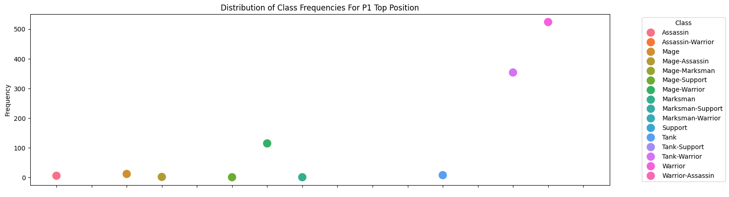
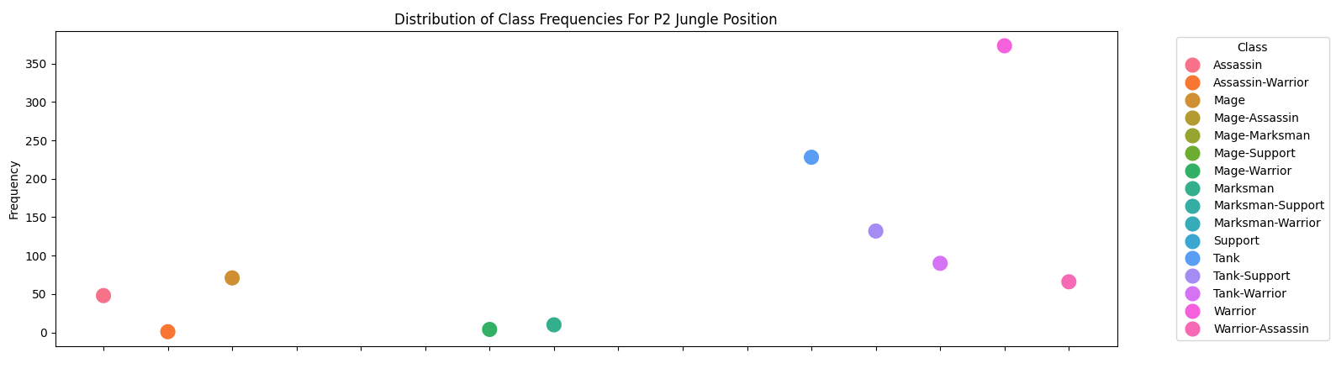
Scatter plot
Notes:
Creating a scatter plot to get a better view of what different classes were picked for each role. To further support the best composition from the bar graph we can see that the most frequent classes selected were indeed the more popular picks when it comes to their own roles. Here is the plots for Top, Jungle.

Slide 10
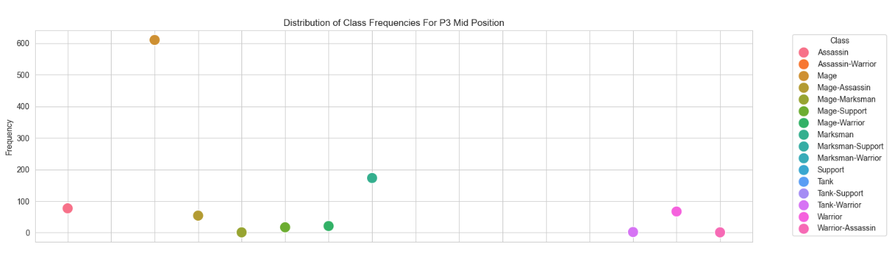
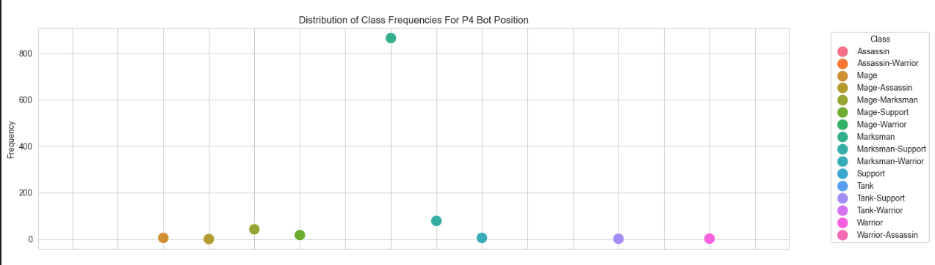
Notes:
Mid, Bot

Slide 11
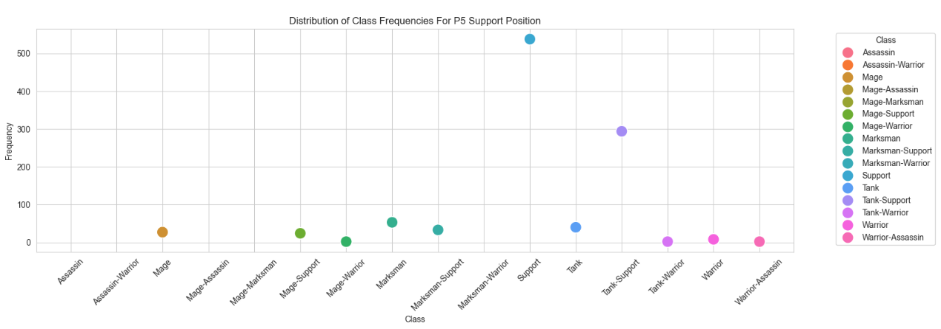
Notes:
And support

Slide 12
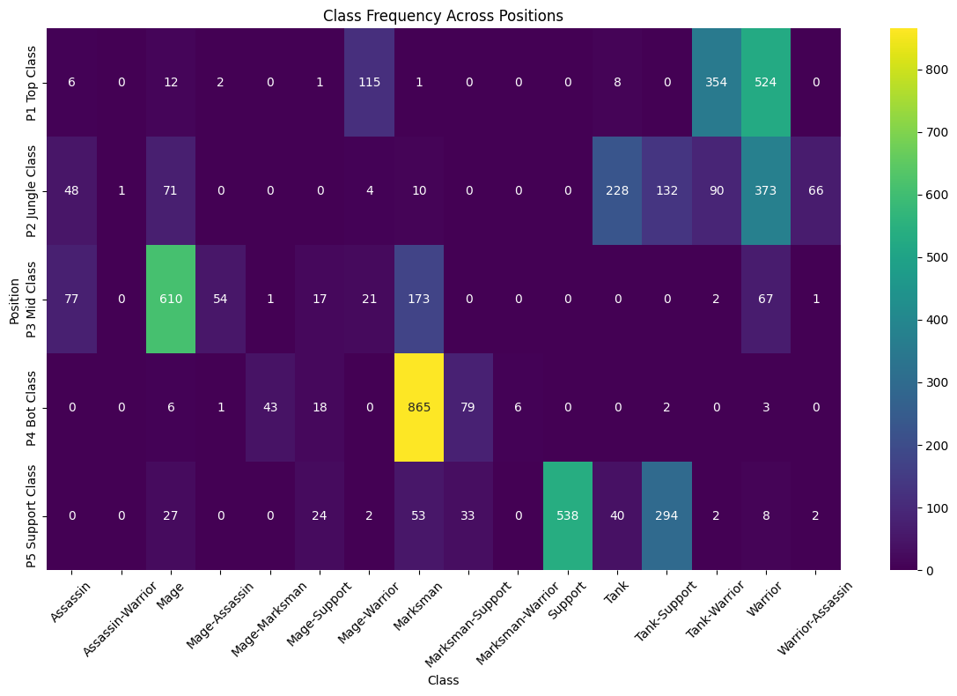
Heat map
Notes:
To confirm our findings and get a rough overview of the best classes for each role, we plotted a heat map showcasing the distribution of each class to each role.

Slide 13
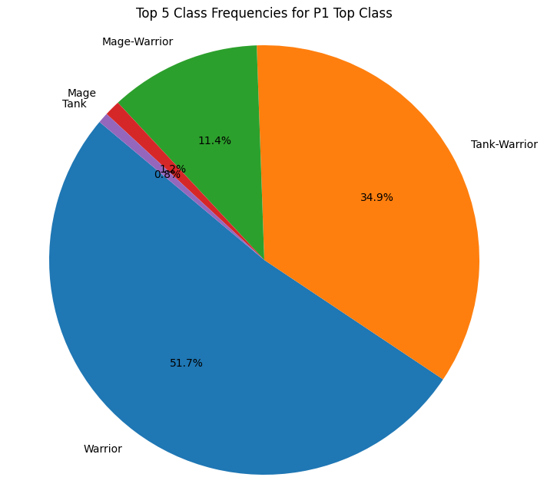
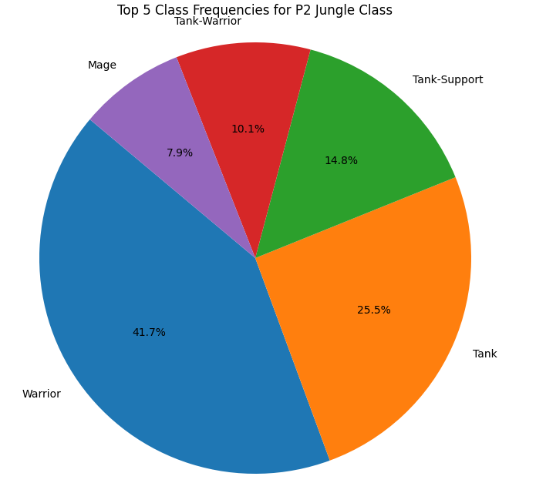
Conclusion
Notes:
Finally, to conclude with based on our findings. The class Warrior is was the most picked class for both Top and Jungle roles.

Slide 14
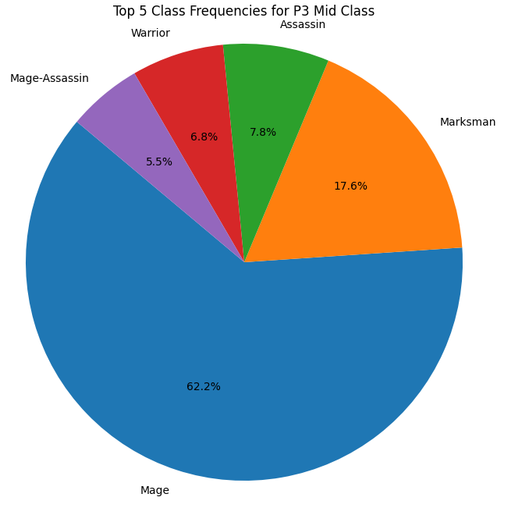
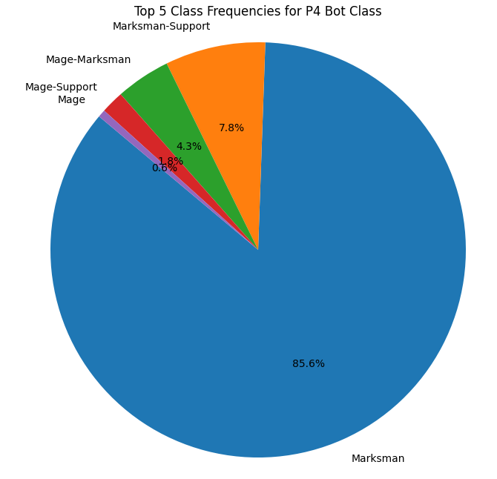
Notes:
Mage and Marksmen for Mid and Bottom roles

Slide 15
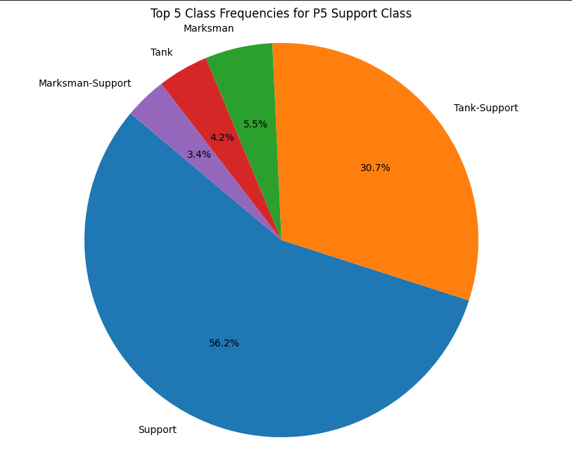
Top: Warrior JUNGLE : WARRIOR MID: MAGE BOTTOM & SUPPORT: MARKSMEN SUPPORT
Best team composition
Notes:
And Support class in the Support role.

Slide 16





















LEAGUE OF LEGENDS IN-GAME GOLD SYSTEM
Gold is the primary in-game currency used in League of Legends match.
It represents wealth and resources accumulated by players and the team during a match.
Gold is mostly earned by killing minions, neutral objective monsters, enemy champions and structures such as turrets and inhibitors.
Gold can be used to purchase items that provides stat boosts, passive and active effects to enhance a champion’s abilities and performance.
Notes:
Before going into our second problem definition, we would like to explain League of Legend’s in Game Gold system.
Gold is the primary in-game currency used in a league of legends match. It represents the wealth and resources accumulated by players and the team in a match.
The only way to earn gold is mostly by killing minions, neutral objective monsters, eliminating enemy champions and taking down enemy structures such as turrets and inhibitors.
This gold can be used to purchase items that can provide a massive stat boost, passive and active effects, enhancing a champion’s abilities and performance.

Slide 17
what is the best variable in predicting the total combined gold value?
Problem Definition #2
Objectives:
Variables that mainly affect gold values are:
Neutral objectives (Baron, Dragon Herald)
Kills
Total CS (Killing Minions)
Taking down enemy structures
Sample and prepare the data.
Performed data exploration and analysis (EDA).
Machine Learning
Based on the observations acquire the best variable to be used predicting the gold value.

Slide 18
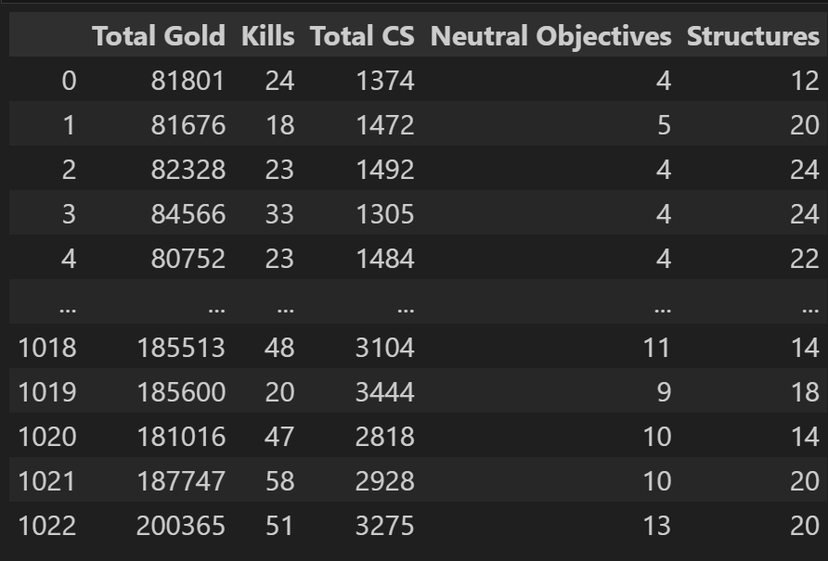
Data preparation
Notes:
We again re-extracted the data we needed from our dataset to acquire the total gold, kills, total cs (creep score a.k.a minion kills), neutral objectives and structures. We then cleaned up and merged the data to combine the statistics of both teams in a match.

Slide 19
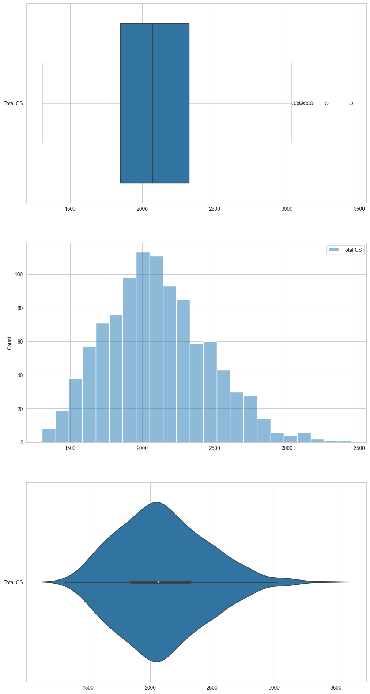
eda
Box plot
We plotted these visuals for each of our variables at play.
Gives a better view of the different statistical values of each variable.
histogram
Violin plot

Slide 20
<Need add more eda>?

Slide 21
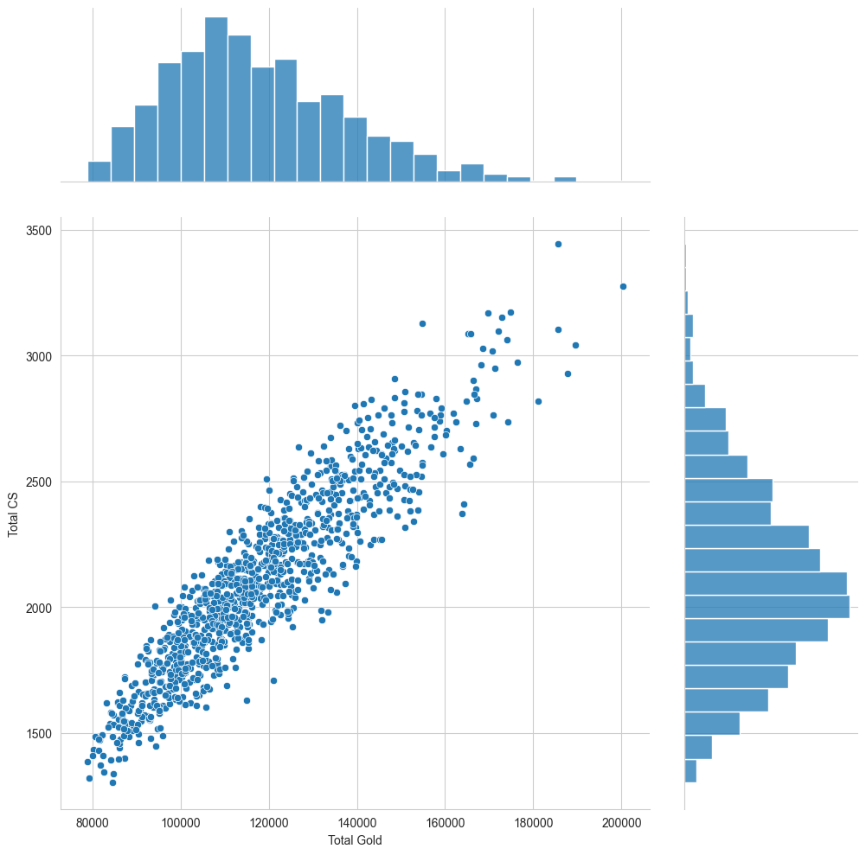
Total cs, total gold
- Based on the diagrams that we have plotted and this joint plot.
- Total CS seems to be the main driving factor when it comes to gold earned.
- We can see from the pattern here; we can see a sharp straight-line increase in both the x and y axis.

Slide 22
<Machine learning>?

Slide 23
Conclusion

